Slide 1

Lower Halstow and Newington CEP Schools Federation and Nursery
Tara Deevoy – Executive headteacher eht@newington.kent.sch.uk
Michelle Crowe – Head of School headteacher@lower-halstow.kent.sch.uk

Slide 2
Our experience of an external audit process
Our Context
Historic poor attendance post covid.
22-23 both schools in bottom three in Swale for attendance and highest for persistent absence.
23-24 improved, particularly at LHS to be just above national overall and halving persistent absence.
However, an increasing amount of SLT and pastoral team time was being taken up dealing with attendance. Attendance officer spent a long-time prepping documents for weekly attendance review meetings. It seemed to be taking over all our time and energy. Positive impact but at what cost?
Governors expressed concern regarding SLT time and were supportive of sourcing additional support.
We needed an objective viewpoint to help us ‘see the wood for the trees’ and identify efficiencies and more streamlined ways of working.
Commissioned an external audit – tried local company but they were maxed out so reached out to Sol having had awareness of their work in Island schools.

Slide 3
The audit process
Gave them read only access to MIS system and they did a full dashboard analysis before coming into school. E.g. missing marks, notes, timings, reports etc. Also did a wider healthcheck – we had just transferred MIS and some things hadn’t come across properly but because we hadn’t had to access them we didn’t know e.g. medical conditions, some second contacts. They came with a full list of everything ‘missing’ from our MIS not just attendance, along with suggestions for how to upload this easily.
They created bespoke reports in our MIS to run off the information we needed each week at the touch of a button e.g. missing marks, minutes late etc. This was presented in a way office staff can easily rectify within a couple of minutes.
Notes:
Probably more useful to us as we were new to our MIS, but we have never run weekly healthcheck reports before in our previous MIS to check for missing or incorrectly coded items, so this was an improvement.

Slide 4
The on-site visit
Two aspects and you don’t have to buy both.
Technical audit – checked MIS processes, compliance, on-rolling and off-rolling, record keeping, coding – lots of questions and suggestions (they have a view about Kent processes, as they work across lots of LAs!!!)
Procedural audit – interview all staff involved with attendance, lots of questions.
Walked office staff through where to find and how to use the report template they’d created for us.
Post visit – rag rated audit (many many sides of A4) with follow up teams call to go through actions required. Some are quick fixes other need extra thought.
Notes:
Onsite visit to go through an audit process – interviews with attendance officers, office staff, FLO/pastoral staff, SLT etc.
Receiving the audit with oranges and reds actually mad us quite angry, as we were having great impact with attendance, but it forced us to reflect on those areas and meant that we were better prepared to ‘defend and promote’ ourselves come inspection time.

Slide 5
Benefits and Impact
OFSTED think we are fabulous ☺
Less officer time spent prepping docs
Key reports available at the touch of a button on our MIS
More focused weekly attendance review meetings with all the information in one place.
Other support available – policy, letters, posters, leaflets, can also email. We pick and choose as they are all included with the tracker.
Improved attendance! Despite rampant illness and multiple holidays, attendance is still going up.
Notes:
Also updated our policy but didn’t use all of the SOL template letters etc, just picked the ones/parts that suited our schools.

Slide 6


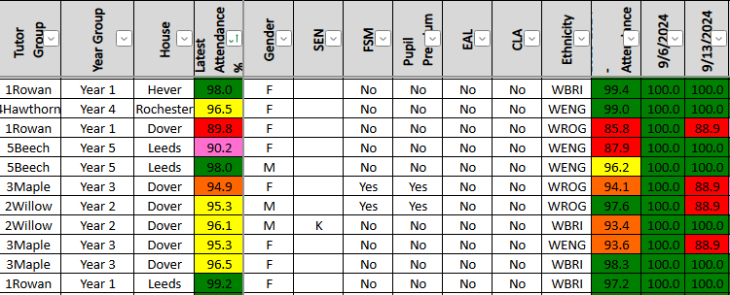
Advantages:
All tracking and absence details kept in one central place on a shared drive, leading to more efficient weekly attendance meetings.
Links directly with MIS, each week the latest attendance data can easily be downloaded from your MIS and pasted onto the tracker.
Easy to track individual pupils; their whole academic year’s attendance is on one spreadsheet.
Can look at whole school figures, classes and all groups.

Slide 7


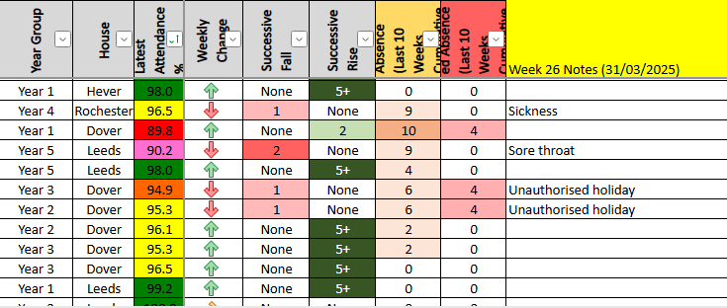
Weekly focus
Sort all attendance by the weekly change arrows, don’t just focus on less than 90%.
Focus on successive rises and falls.
Add notes onto the children whose attendance is dropping.

Slide 8
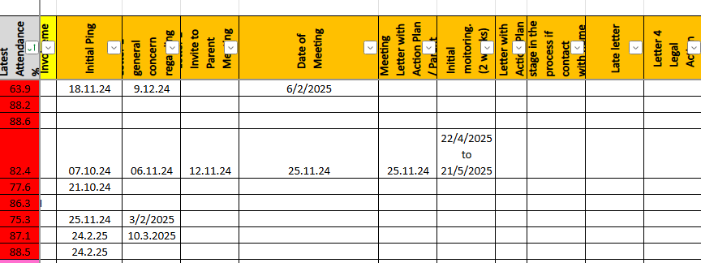
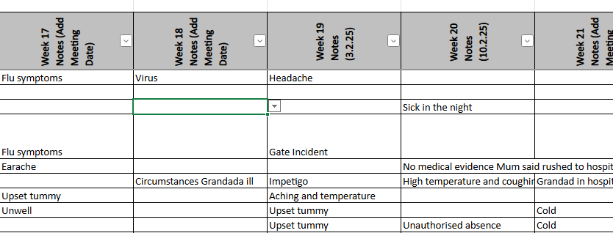
Actions:
Scroll along each pupil’s attendance to add dates of key steps, easy to track the action that has been taken.
Each week, archive the meeting notes into the end of the tracker so current information is easy to access on the screen.
Notes:
You can adapt the SOL tracker template to suit your own process, eg the ping being the first contact we make when attendance initially drops.

Slide 9
GRT families – a fresh approach
We noticed a lack of engagement from GRT parents with formal attendance processes and discussions. There was also low attendance within that demographic.
Changes made:
Verbal invitation from Wellbeing lead for an informal ‘pop in’ meeting, with themselves and the Head of School, instead of email or letter sent from attendance officer.
No paperwork visible at the meeting (attendance on a post-it note) no laptop on desk.
Start the meeting with ‘we just wanted a chat as we’ve noticed ?? attendance has dropped’ is there anything we can do to help?
Emphasizing any positives, thanks for coming, sending them away with a positive vibe about their child increasing their time in school.
Record discussions from the meeting after they have left.
Impact – all GRT families invited to attend meetings in this way have engaged.
  Medical evidence being provided more regularly.
  Families are more open about absences their children are having rather than not contacting the school.
  GRT attendance has shown an increase since the start of the year.

